Slide 1

DIP Uavionics Phase 1
Installation of Arduino Pro Micro
AT Command of HC-06

Slide 2
In this 4 weeks, you will be able to…
Design and build your very own Unmanned Ground Vehicle (UGV).
Establish a wireless communication between a micro controller and your android phone.
Write a program to maneuver your UGV and collect data for you!

Slide 3
Components Provided
Arduino Pro Micro w/ cable x1
Motor Driver x1
Bluetooth Module x1
RFID Reader x1
Jumper Cables
Corrugated Plastic (A3 size) x0.5
Wheels x2
DC Motors w/ Brackets x2
Ball Caster Plastic x1
AAA Batteries (100%) x6
3AAA Battery Carriage x2
Mini Breadboard x1
Components Unprovided
Android Phone (minimum 5 inch) x1
Laptop x1
Google mail account x1
Miscellaneous equipment
eg. Scissor, pen, pencil, markers, etc

Slide 4
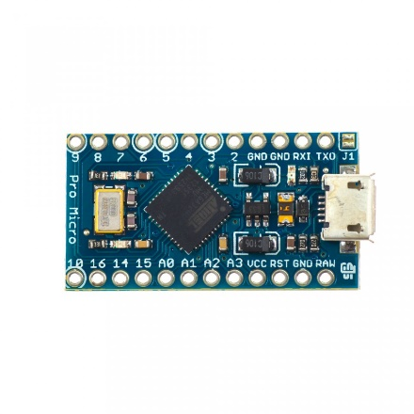
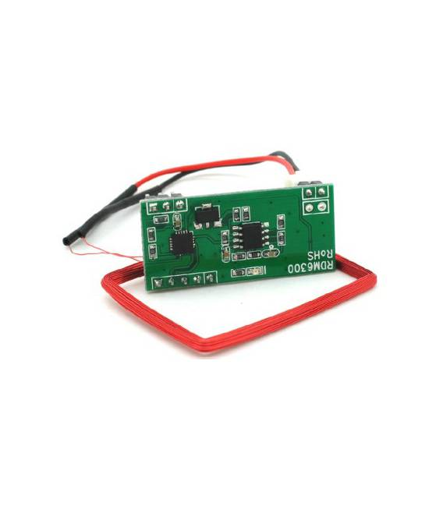
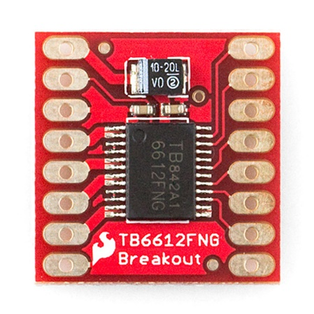
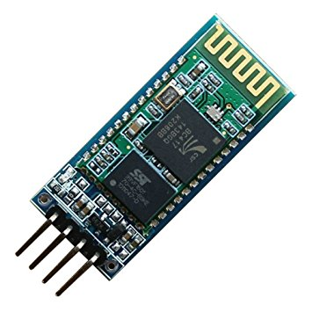
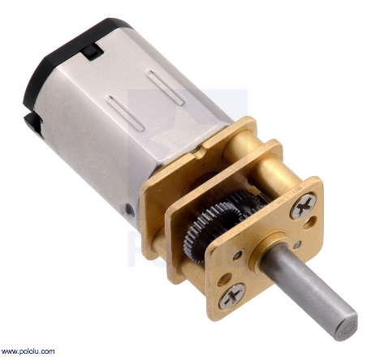
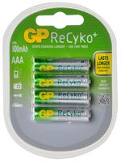
Arduino Pro Micro
5V, 16MHz
RFID Reader RDM6300
5V, 125kHz
Motor Driver TB6612FNG
5V VCC, 15V VM, 1.2-3.2 A
Bluetooth Module HC-06
5V, 2.4GHz, 9600bps
Micro Metal Gear Motor
50:1
GP Rechargeable Battery
AAA, 800mAh, 1.2V
Note that all the descriptions above are summarized and simplified.
For more detailed and accurate information, please refer to individual datasheets or official websites.

Slide 5
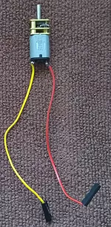
Building Procedures
DC Motor
Step 1:
Solder the male-to-male wires to the DC motors
Soldering Tutorial (Recommended):
https://youtu.be/f95i88OSWB4
Wire

Slide 6
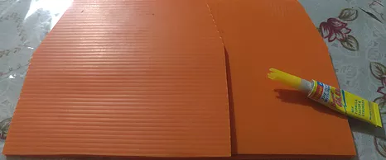
Building Procedures
Step 2:
Creating the body of the bot and the wheels
Given a large piece of corrugated plastic board
Cut it into 2-4 small pieces
Design them into your desired shapes and sizes

Slide 7
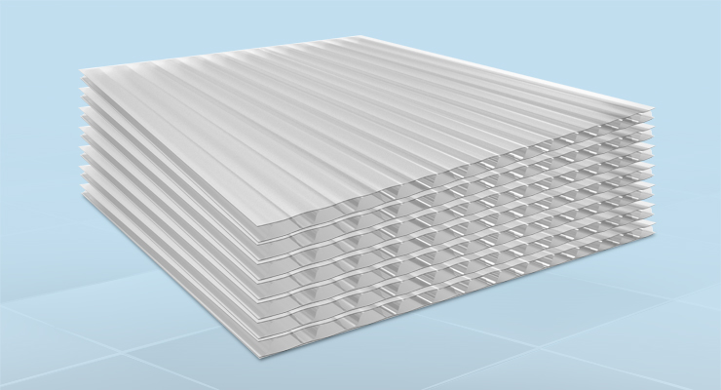
Building Procedures
Step 2:
Creating the body of the bot and the wheels
After designing, stack the boards up using glue or double-sided tapes

Slide 8
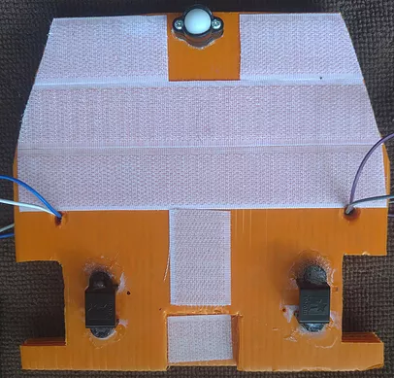
Building Procedures
Step 2:
Position the castor ball at the head of the car
Secure the brackets onto each side of the UGV
*Hints*
Holes like this can be drilled across the boards for neater connections

Slide 9
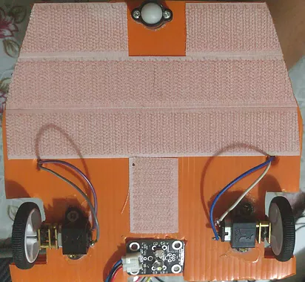
Building Procedures
Step 2:
Insert the motors through the bracket
Attached the wheels to the motors

Slide 10
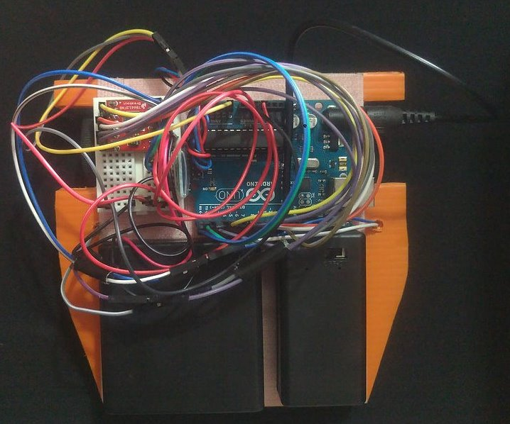
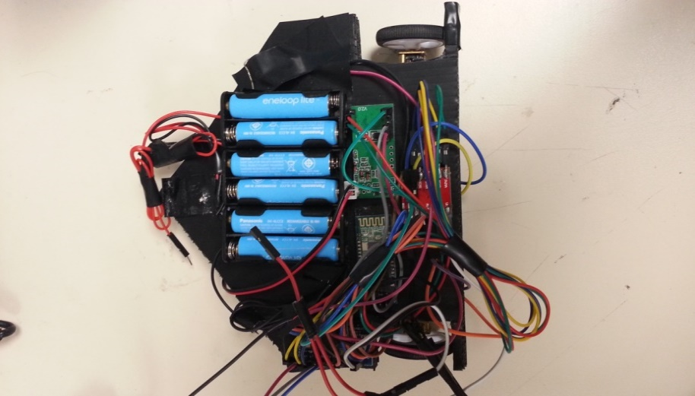
Building Procedures
Step 3:
Assemble and make connections
Solder the necessary components according to the schematic diagram shown on the next slide
Usage of mini breadboard can be optional
These samples are only for illustration purposes, please do not use them as your technical reference
Sample
Sample

Slide 11
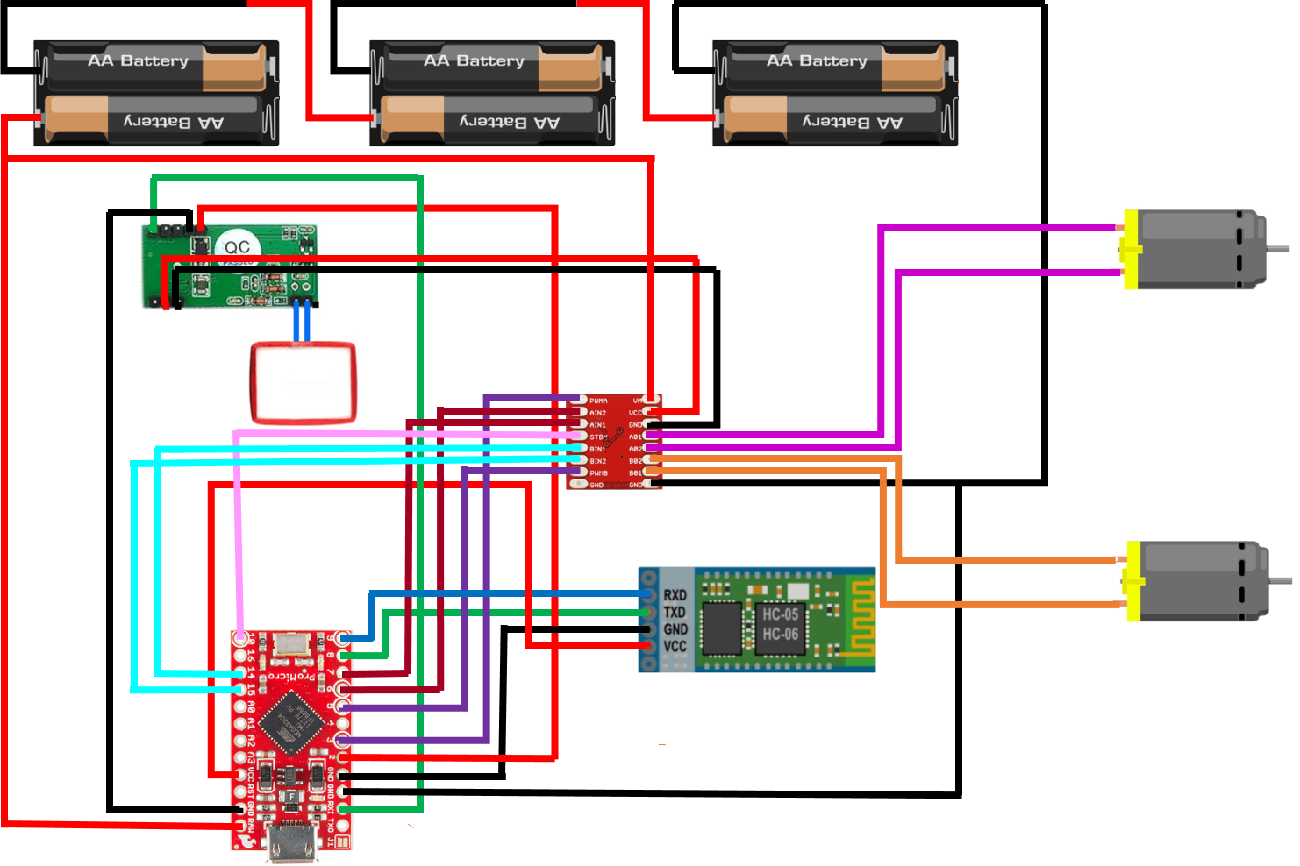
Schematic diagram

Slide 12
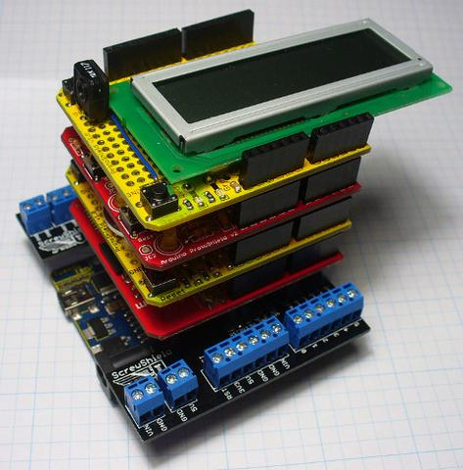
Building Procedures
Step 3:
Be creative with the placement of your components!
Make them neat, tidy and efficient!

Slide 13
Building Procedures
Step 4:
Download Android Interface
*Note that this app only work on Android products and the link can only be access after you login using a Gmail account*
Link to MIT app inventor:
https://www.google.com.sg/url?sa=t&rct=j&q=&esrc=s&source=web&cd=1&cad=rja&uact=8&ved=0ahUKEwig4qS1sIjVAhWFsI8KHWHvDjQQFggkMAA&url=http%3A%2F%2Fai2.appinventor.mit.edu%2F&usg=AFQjCNENN1q-Na-ChHx4i5uQR_BacpF1Hw

Slide 14
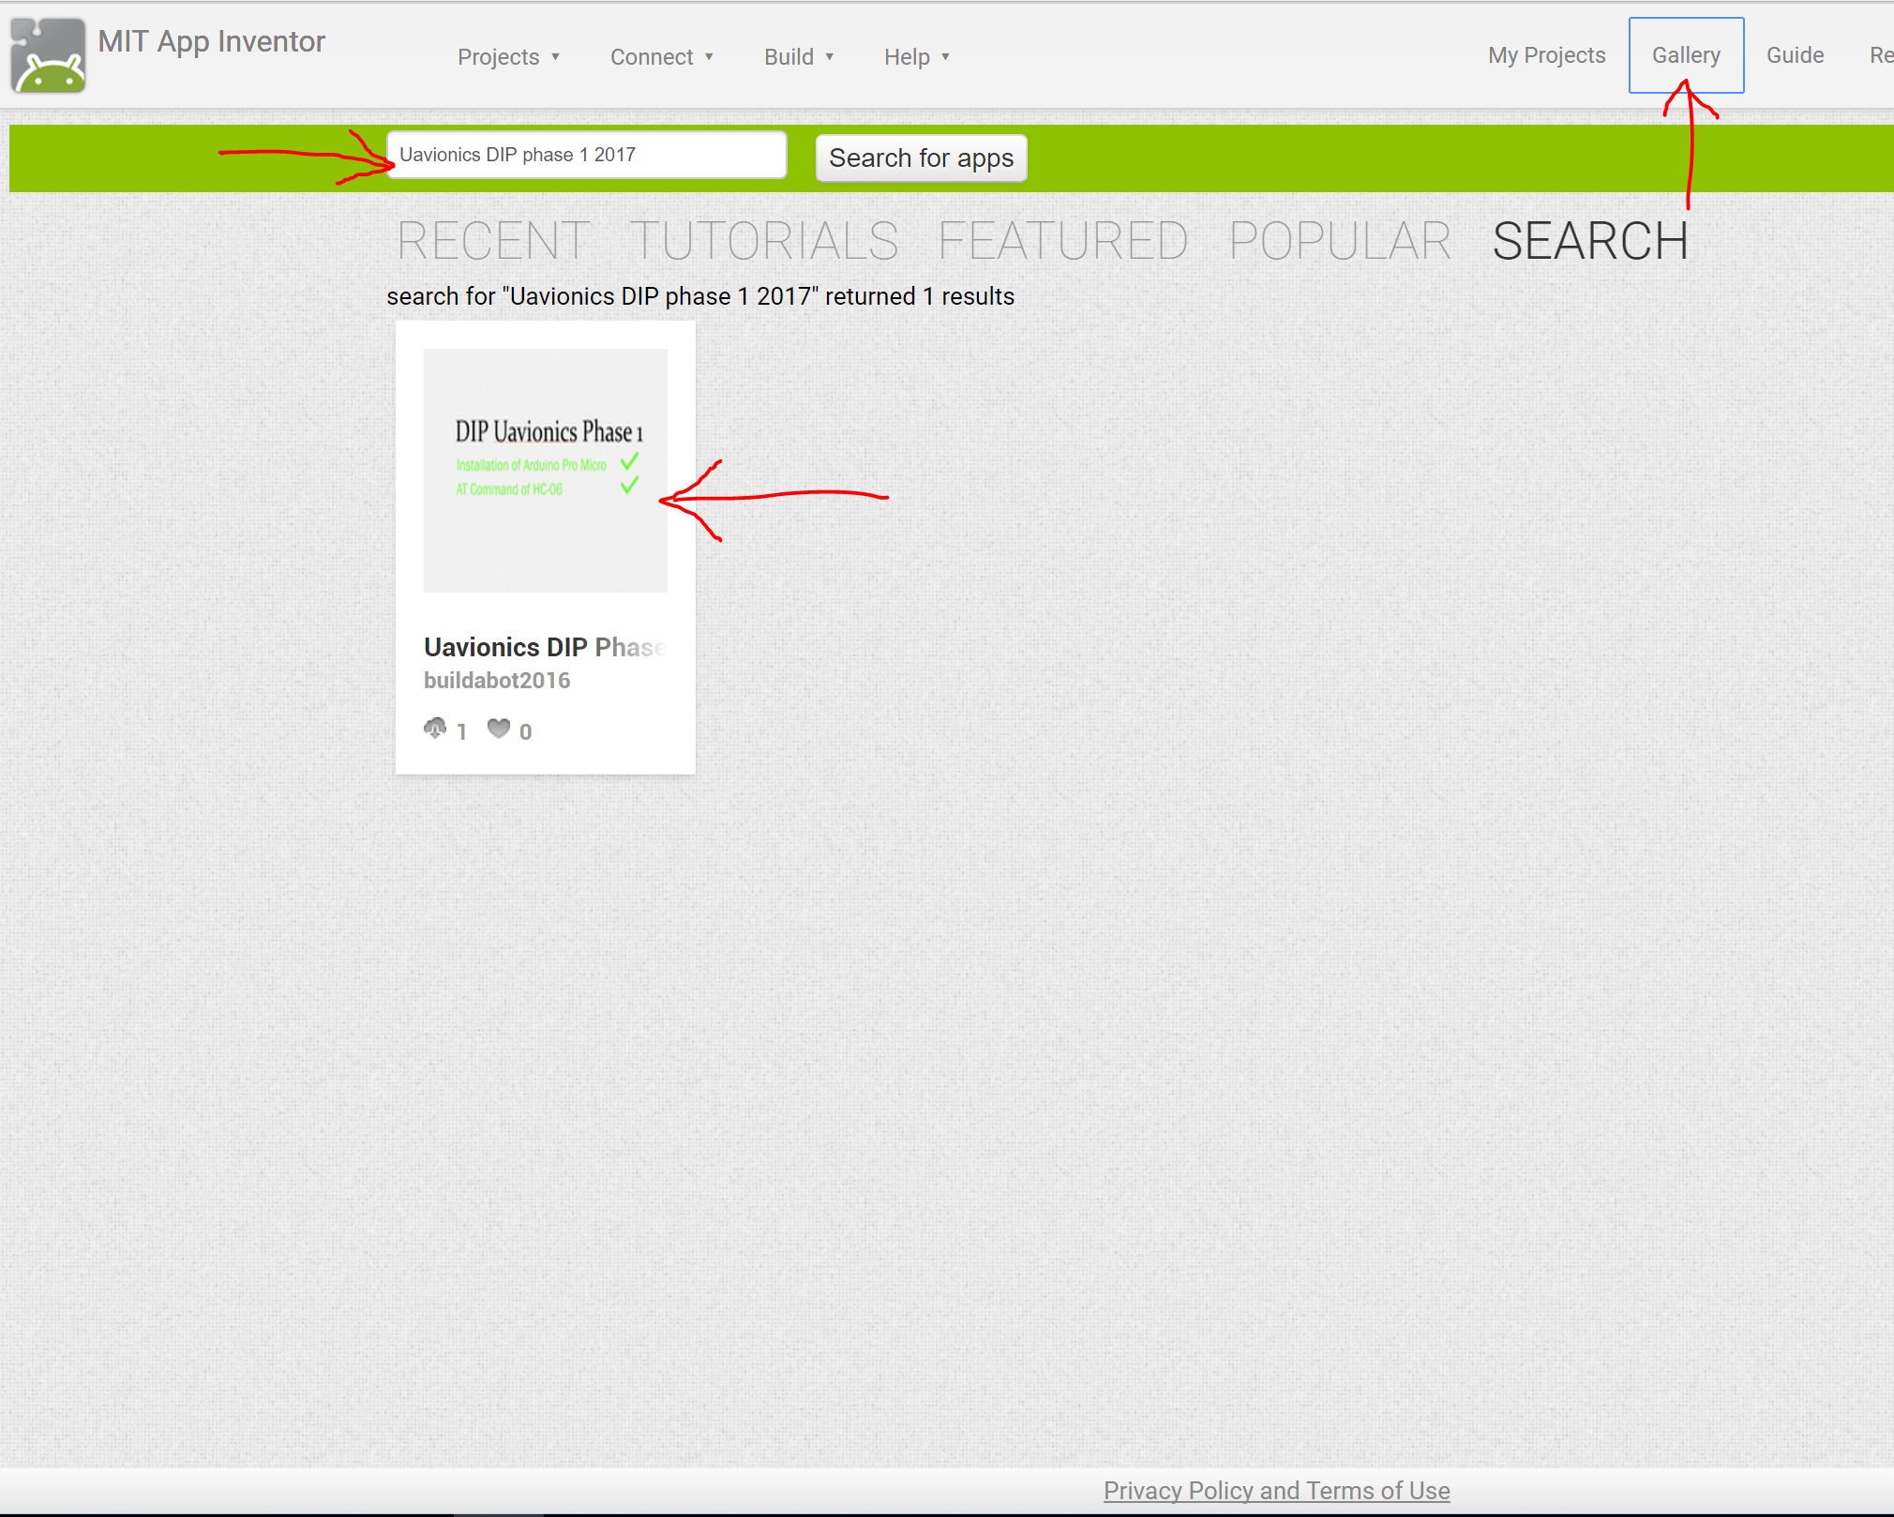
Building Procedures
Step 4:
Download Android Interface
Once you login, click on Gallery and search for ‘Uavionics DIP Phase 1 2017’
Next, click on ‘OPEN THE APP’

Slide 15
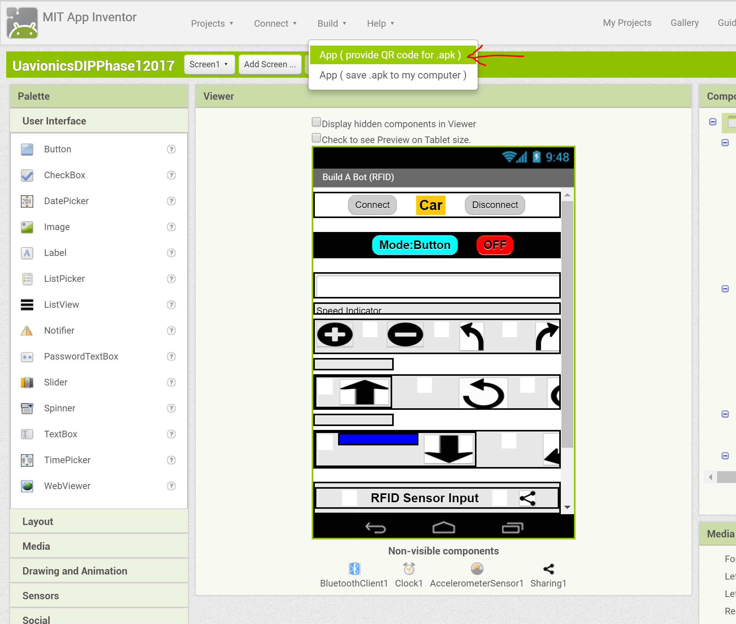
Building Procedures
Step 4:
Download Android Interface
You should see a interface like this
Click on Build>App(provide QR code for .apk)

Slide 16
Building Procedures
Step 4:
Download Android Interface
Scan the QR code using you Android phone
Once done, install the app onto your Android phone
*Note that you may need to adjust your phone security setting in order to install the app*
Checkout the link below if you have trouble with the installation:
https://www.applivery.com/docs/troubleshooting/android-unknown-sources

Slide 17
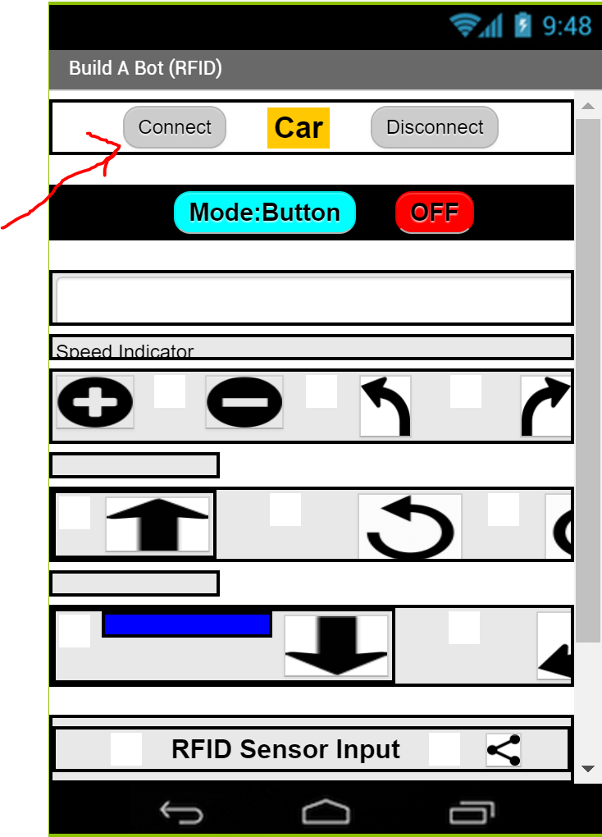
Building Procedures
Step 5:
Testing of Connectivity “
After the installation, run the app and your should see a similar interface as shown on the right.
Power up your Arduino via USB cable and touch on the ‘Connect’ button
Search for your device name and enter the PIN number, your device should be connected after a few seconds

Slide 18
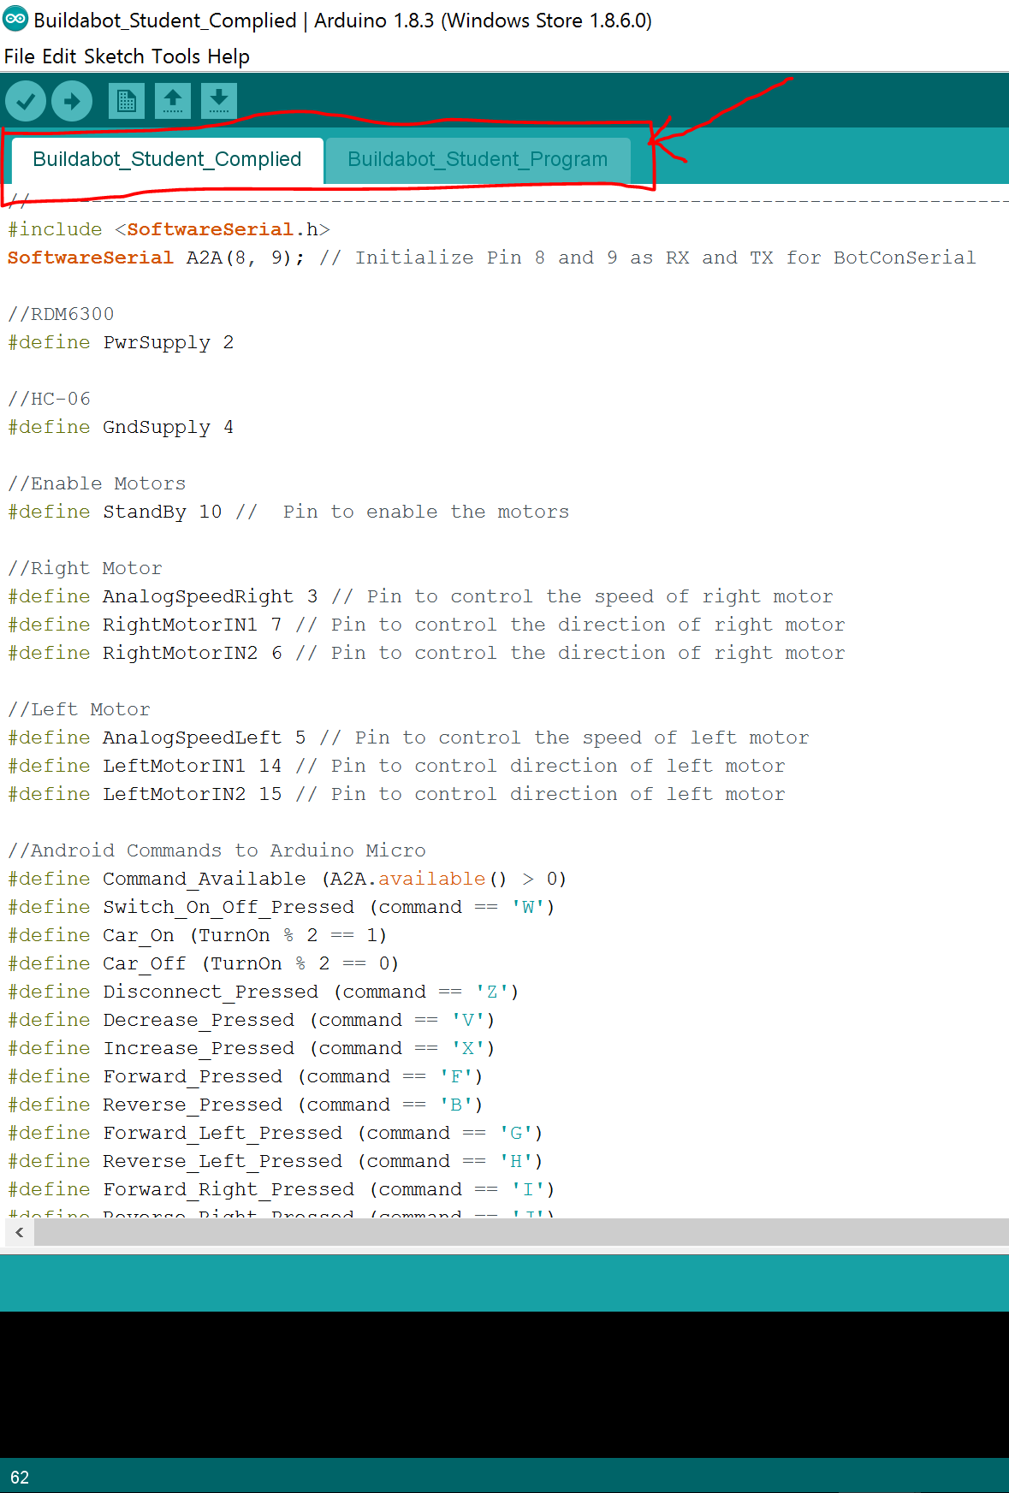
Building Procedures
Step 6:
Download of Arduino Code
Link to Arduino code:
https://drive.google.com/open?id=0B2C6PQtZx06ySGxCUW9EX21RVU0
Click on ‘DOWNLOAD ALL’
Unzip the zip file and there should be two ino files in the folder
Click on either file and open it using Arduino IDE
Your window should consists of 2 tabs
For now, you can ignore the first tab and click the second tab

Slide 19
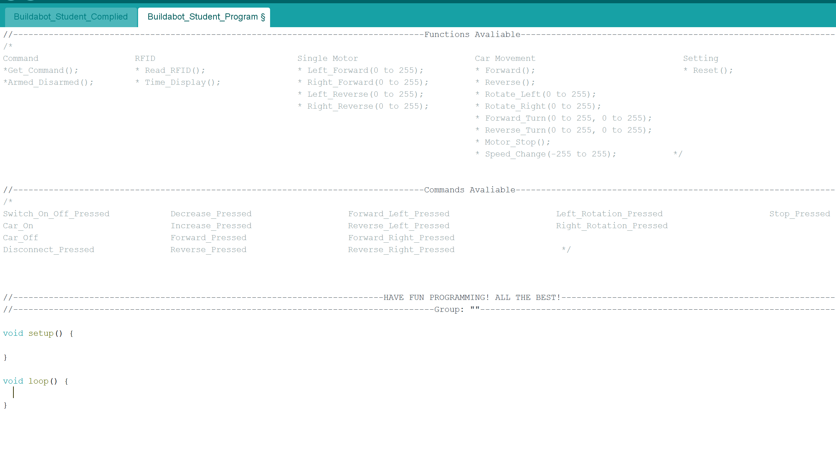
Building Procedures
Here are the functions available for you to call.
Each function will perform a specify task. Eg. Calling Forward() in the main loop will instruct your UGV to move forward

Slide 20
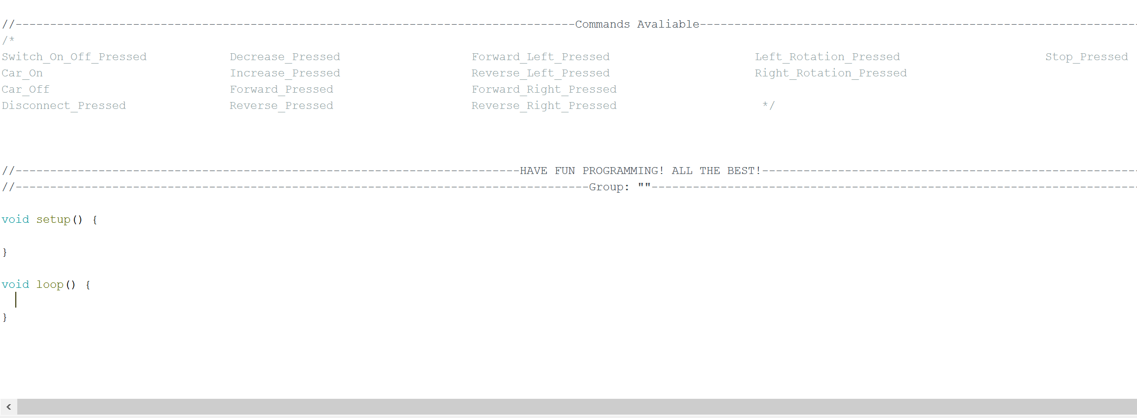
Building Procedures
Here are the commands available for your UGV to know what you have pressed on your interface.
Each command represents a specify button on your interface. Eg. Writing a if loop with a condition of (Forward_Pressed()) simply means ‘if the forward button is pressed on your interface’

Slide 21
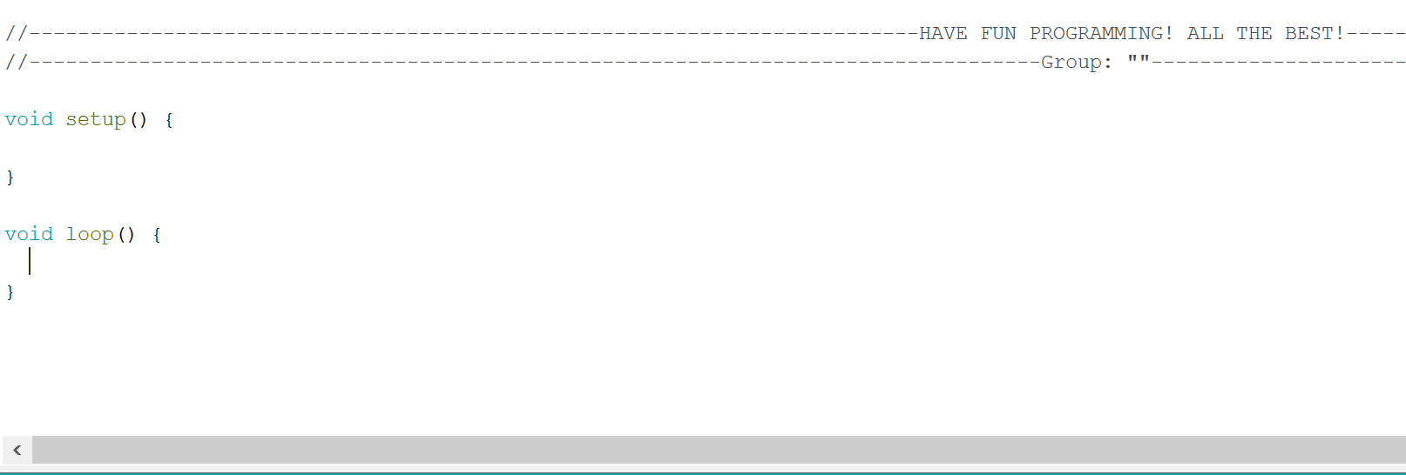
Building Procedures
Codes written in this loop will only be run once
Codes written in this loop will be run continuously
Please enter your group name here
Here is the part that you have to complete.
Basically, you are task to write out an algorithms on how your UGV should react to your commands.
*Hints*
No clues on how to begin with? Get some help here!
https://www.arduino.cc/en/Reference/HomePage

